Slide 1
QUANTIFIERS, QUANTITIES AND CONTAINERS
Rosas Santos Diana
Rodríguez Martínez Estefania Berenice

Slide 2
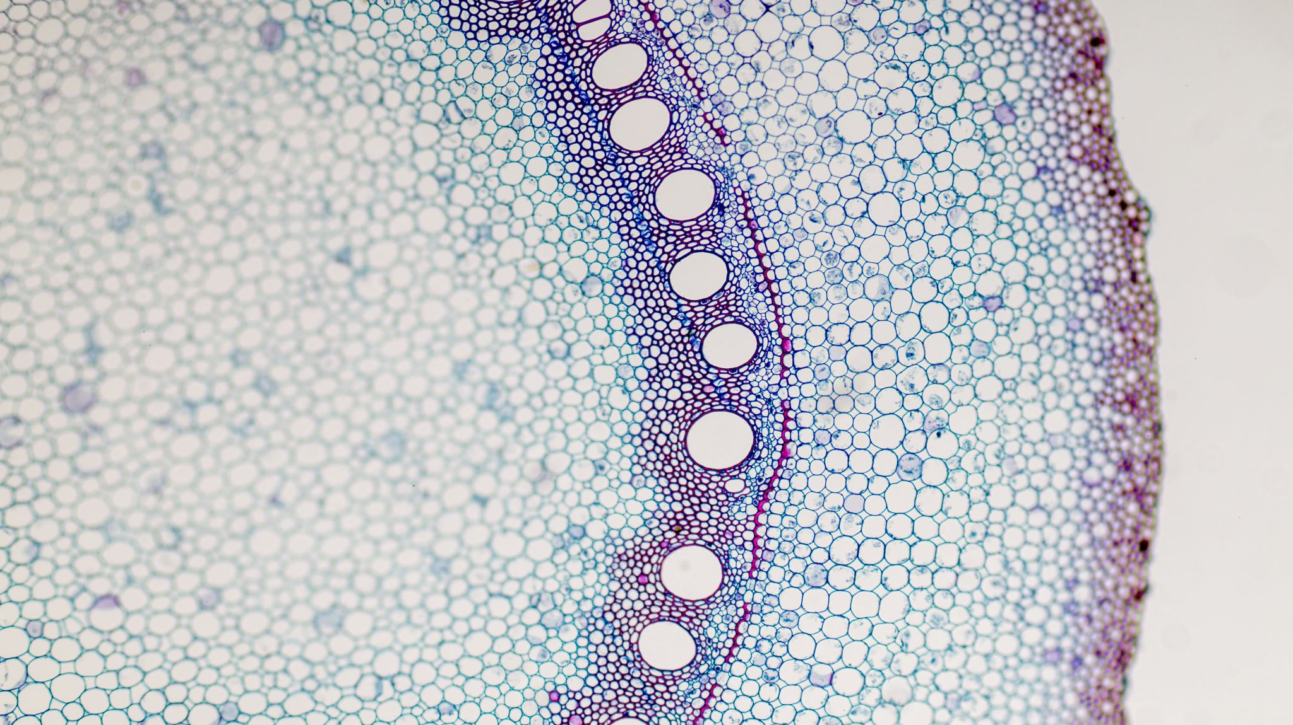
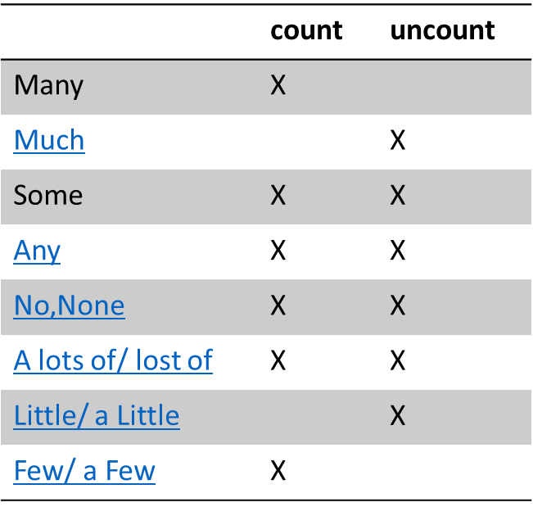
QUANTIFIERS
We use quantifiers when we want to give someone information about the number of something: how much or how many.
We can use these quantifiers with both count and uncount nouns:

Slide 3
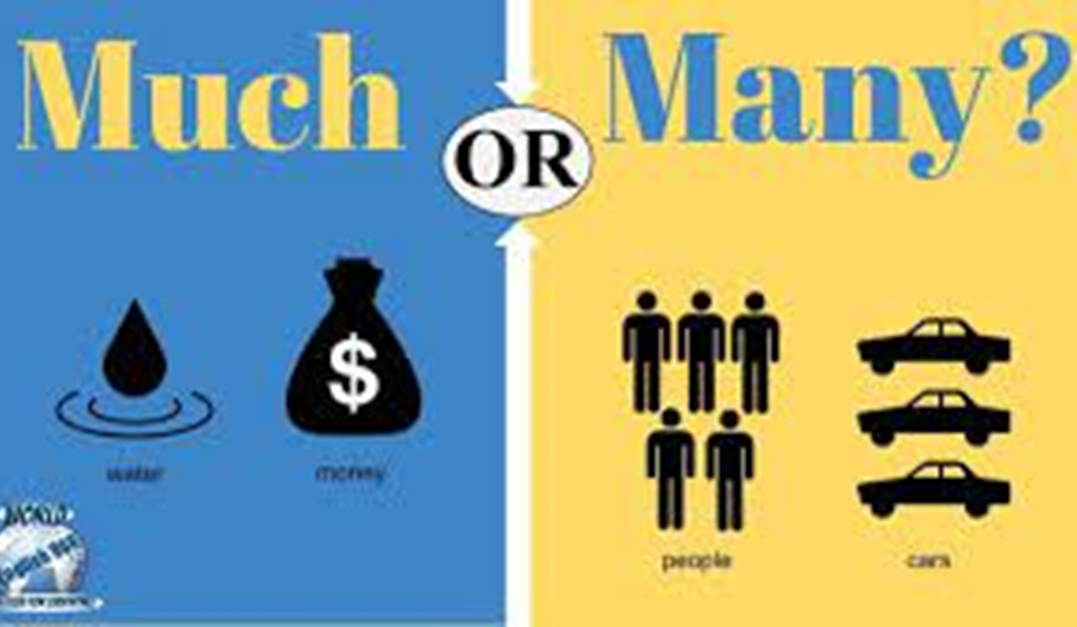
Many/Much
There are not many tourists.(No hay muchos turistas.)
How many cats do you have?(¿Cuántos gatos tienes?)
We have many friends.(Tenemos muchos amigos.)
There is not much time .(No hay mucho tiempo.)
How much money does he have?(¿Cuánto dinero tiene?)
We have much to do!(¡Tenemos mucho que hacer!)

Slide 4
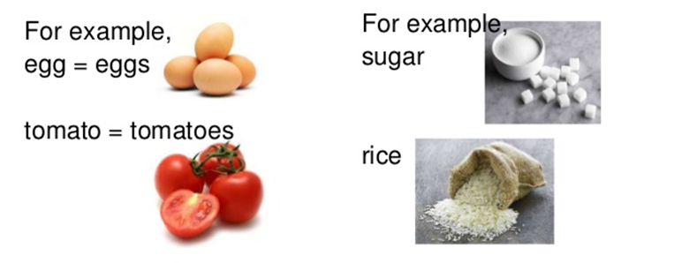
Some / Any
We use some and any, when we want to express an indeterminate quantity when referring to a noun but we don't want to say exactly what that quantity is.
Any:
I haven’t received any emails from my boss.
Do you have any questions for me?
Some:
Some people in the office prefer to have lunch outside.
Would you like some coffee?

Slide 5
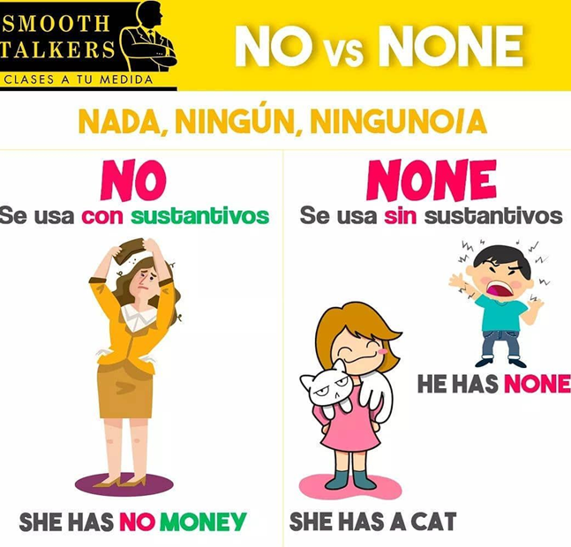
No-None
I’ve got no time for you.
She has no friends
None of my children have been ill.
The judge believed none of what she said.
How many pencils are there? None.(¿Cuántos lápices hay? Ninguno.)
There are no pencils.(No hay lápices.)
How much money do you have? None.(¿Cuánto dinero tienes? Nada.)
I have no money.(No tengo dinero.)

Slide 6

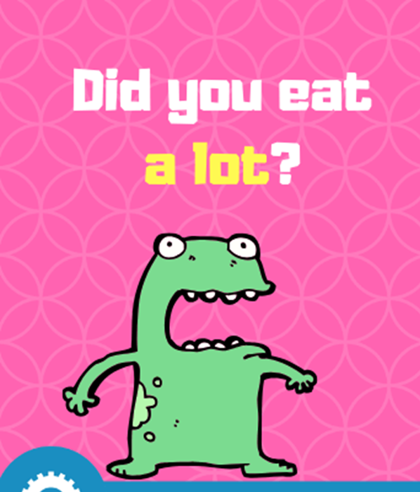
A lots of/ lost of
He has a lot of books.(Tiene muchos libros.)
He does not have a lot of books.(No tiene muchos libros.)
I have lots of money.(Tengo mucho dinero.)
I do not have a lot of money.(No tengo mucho dinero.)
I have a lot of work to do.
I have made a lot of mistakes in my life.
Lots of old movies and songs are in the public domain.
Lots of people came to the house to see the new baby.

Slide 7
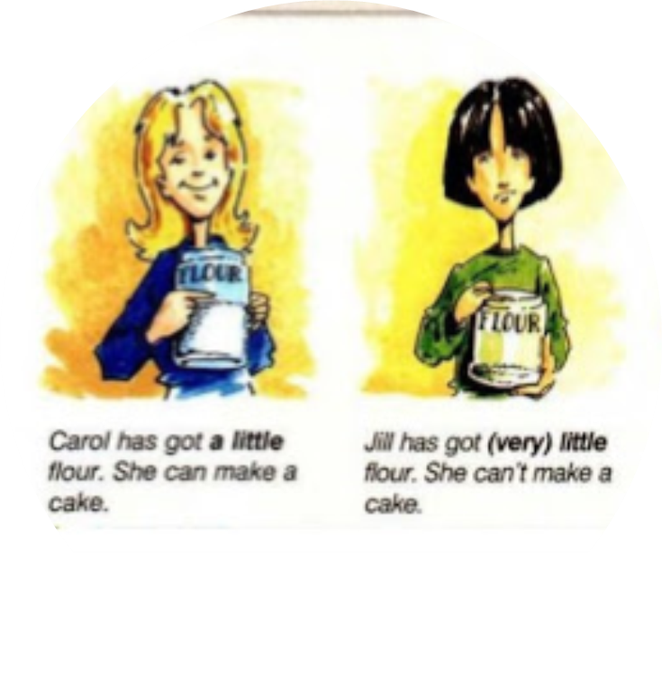
Little/ a Little
Little:
I had little time to prepare my exam and I failed.
I have little money, I can’t buy a new car.
A little:
I have a little money, enough for a new dress.
She saves a little money every month.

Slide 8
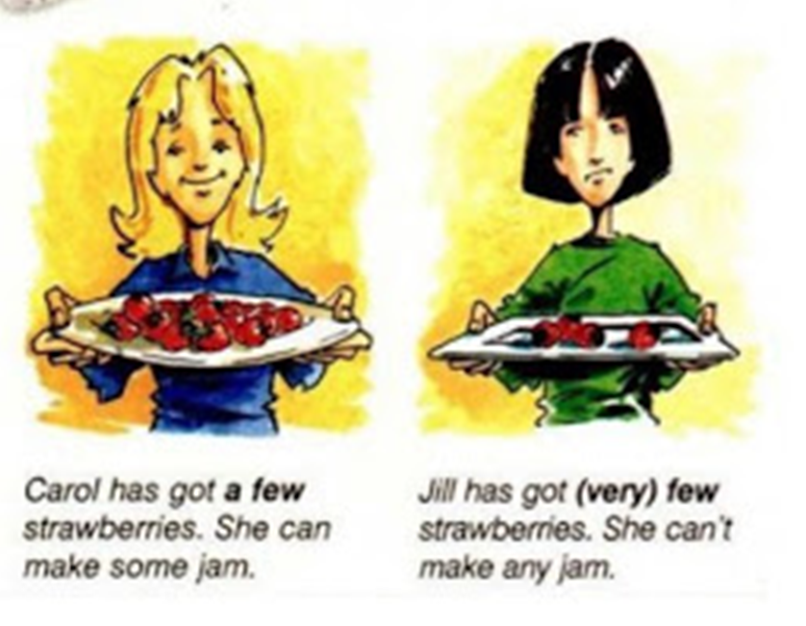
Few/ a Few
Few:
She had few moments on her own.
Few cities in the world can compete with Paris.
A few:
We stayed a few days in Paris visiting its museums.
I just need a few hours to finish my book.

Slide 9
QUANTITIES - Cantidades
ENGLISH | SPANISH
a dozen | una docena
a half | una mitad
a handful | un puñado
a heap | un montón
a mouthful | un bocado
a pair | un par
a piece | un pedazo
a quarter | un cuarto
a slice | una rebanada
a spoonful | una cucharada
a stack | una pila
ounce | onza
kilo | kilo

Slide 10
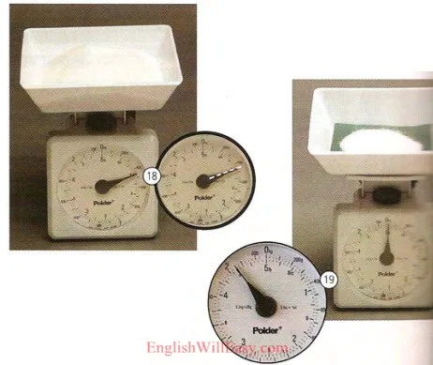
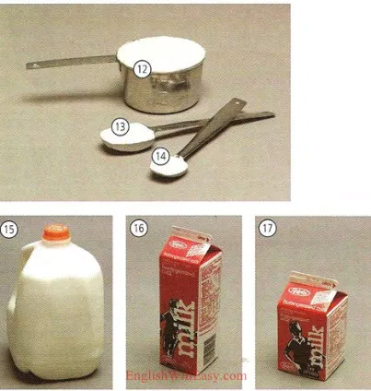
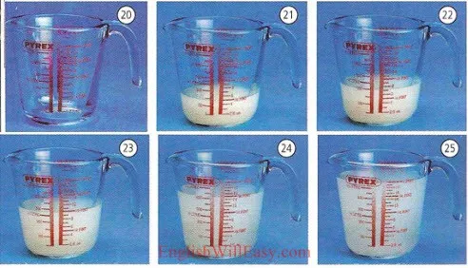
half a dozen | media docena
ton | tonelada
pound | libra
gramme | gramo
liter | litro

Slide 11
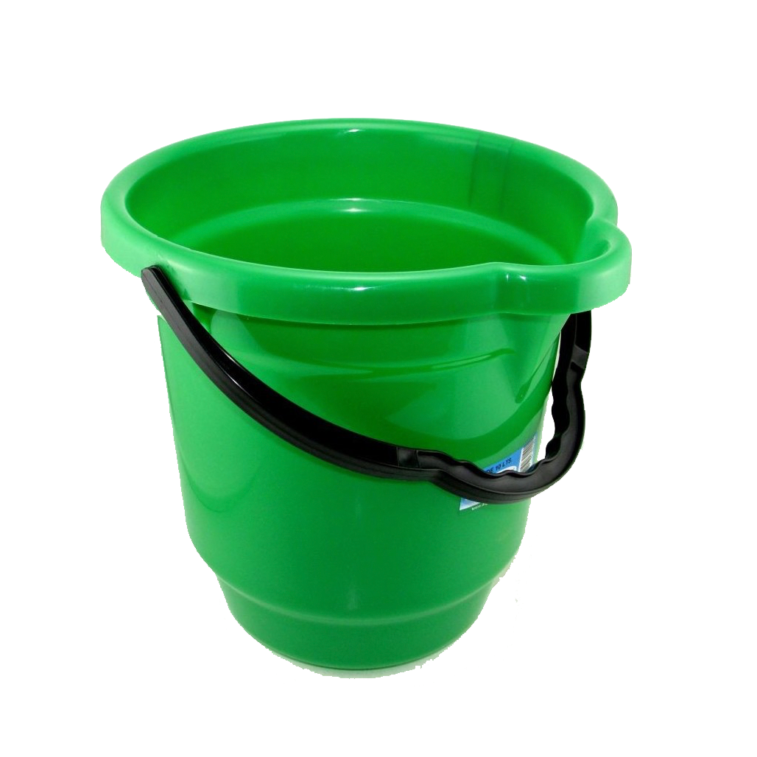
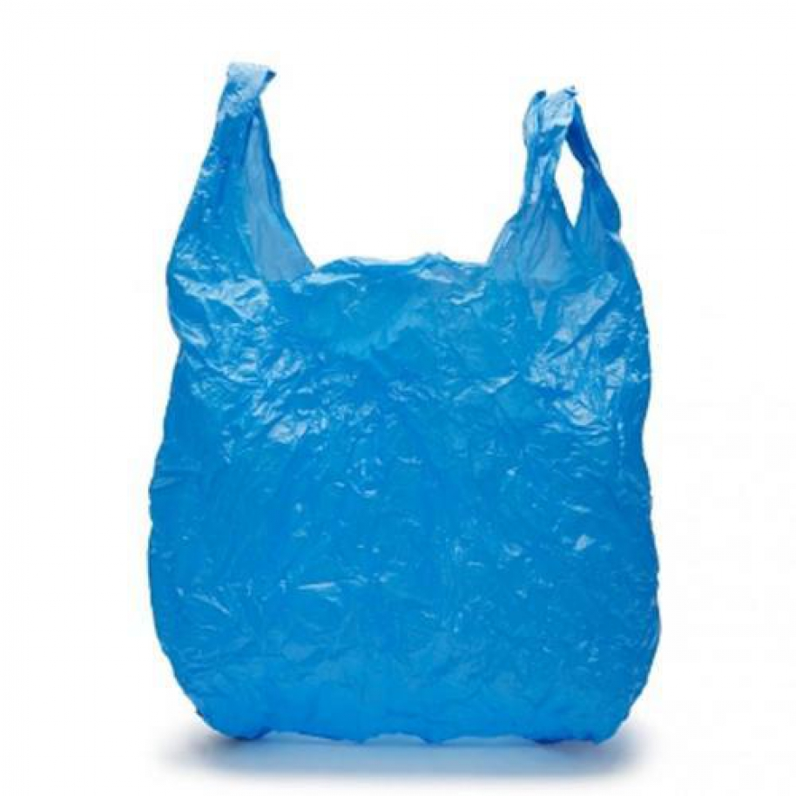
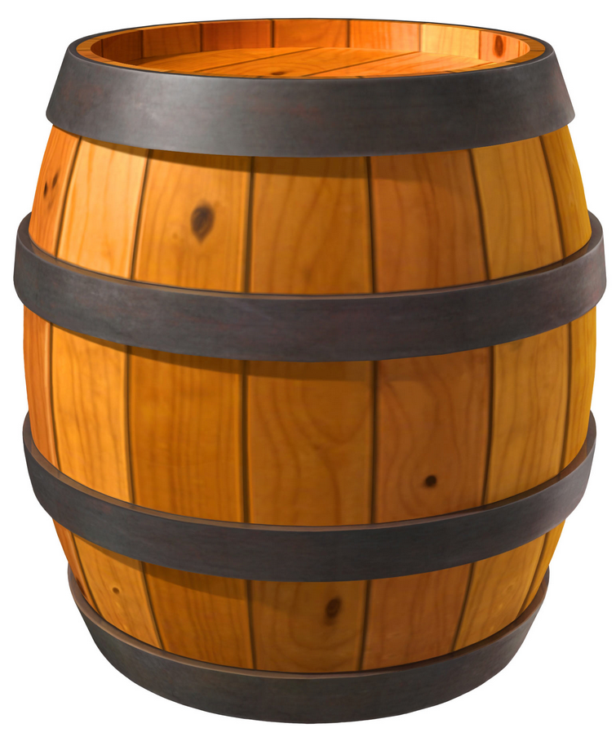
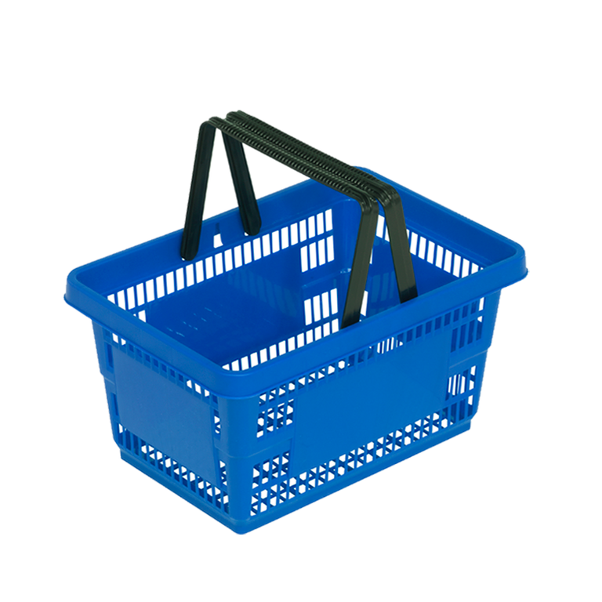
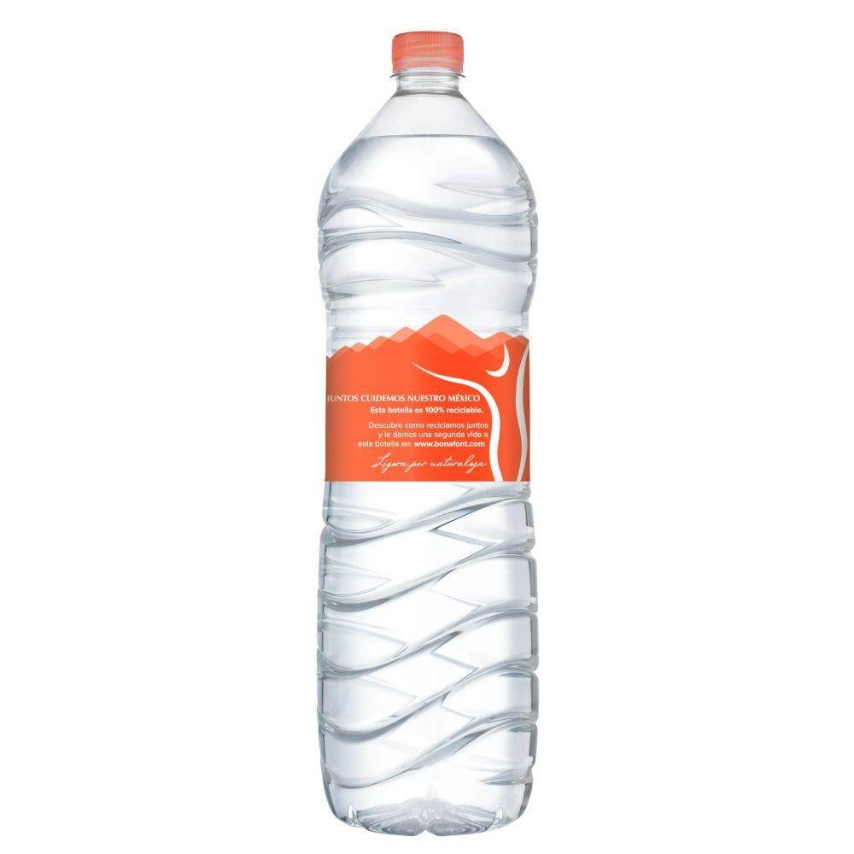
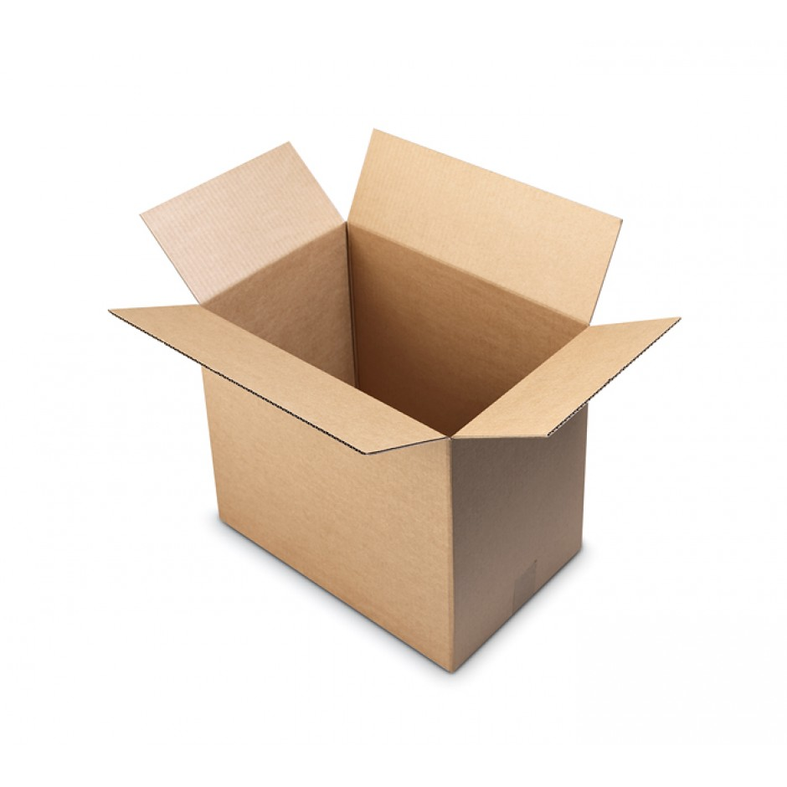
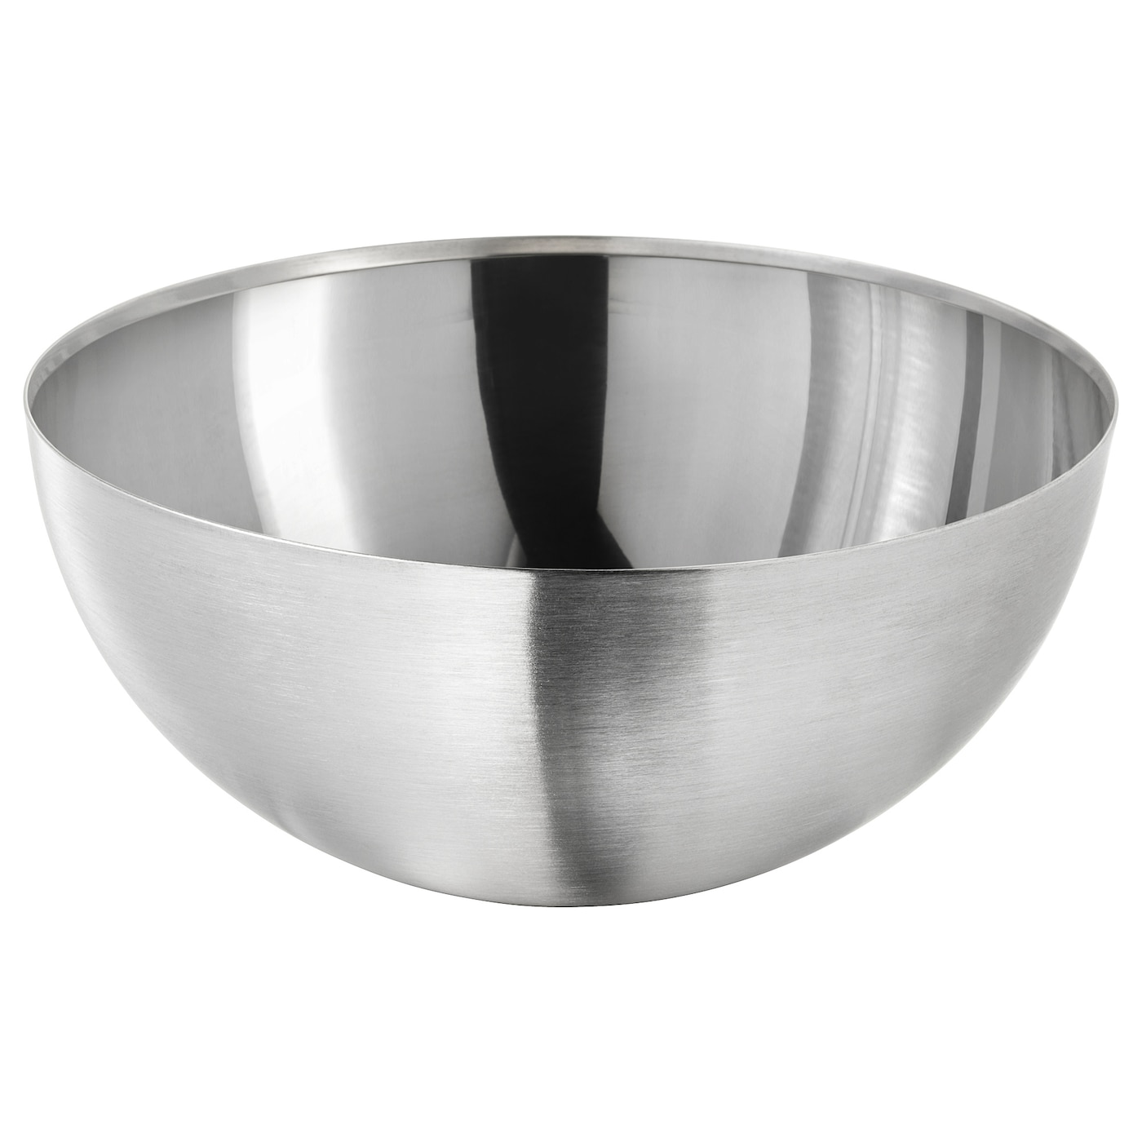
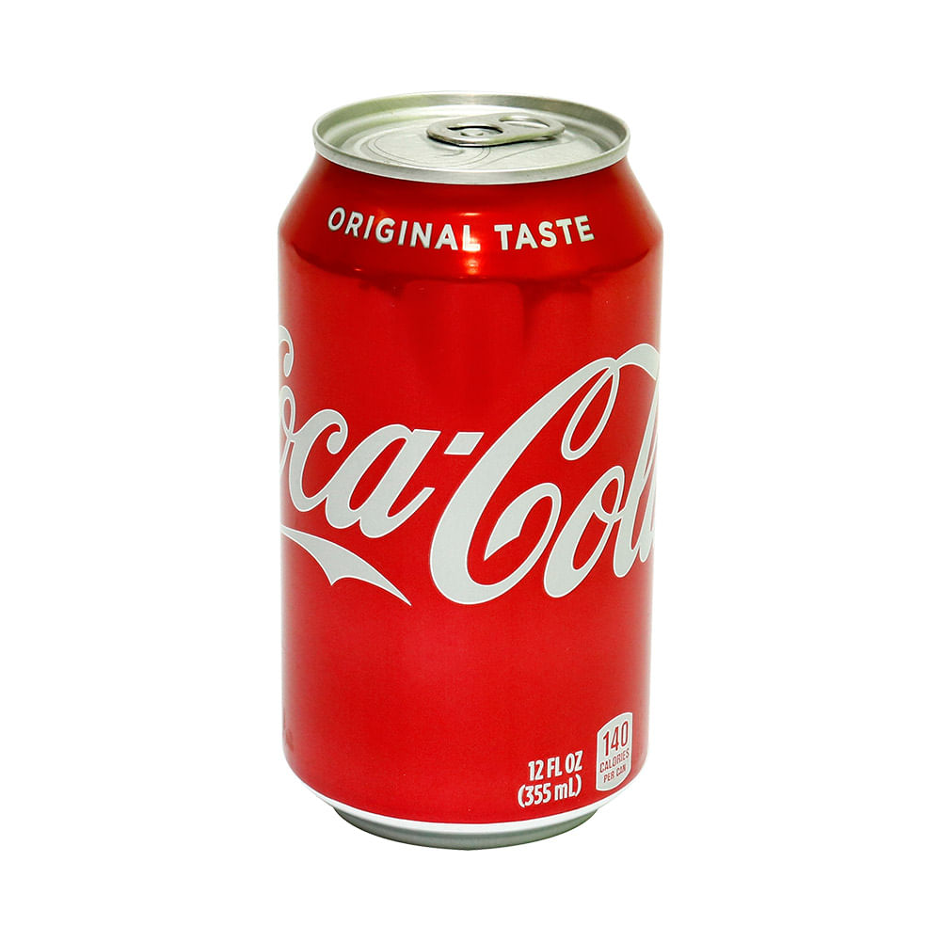
CONTAINERS Envases
Bag – bolsa
Bucket – balde
Barrel – barril
Basket - canasta
Bottle - botella
Bowl – bol
Box - caja
Can - lata

Slide 12
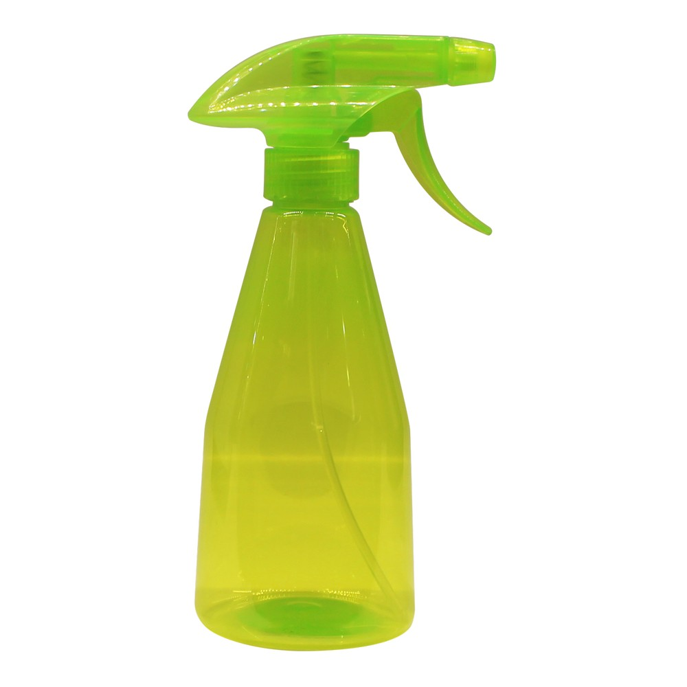
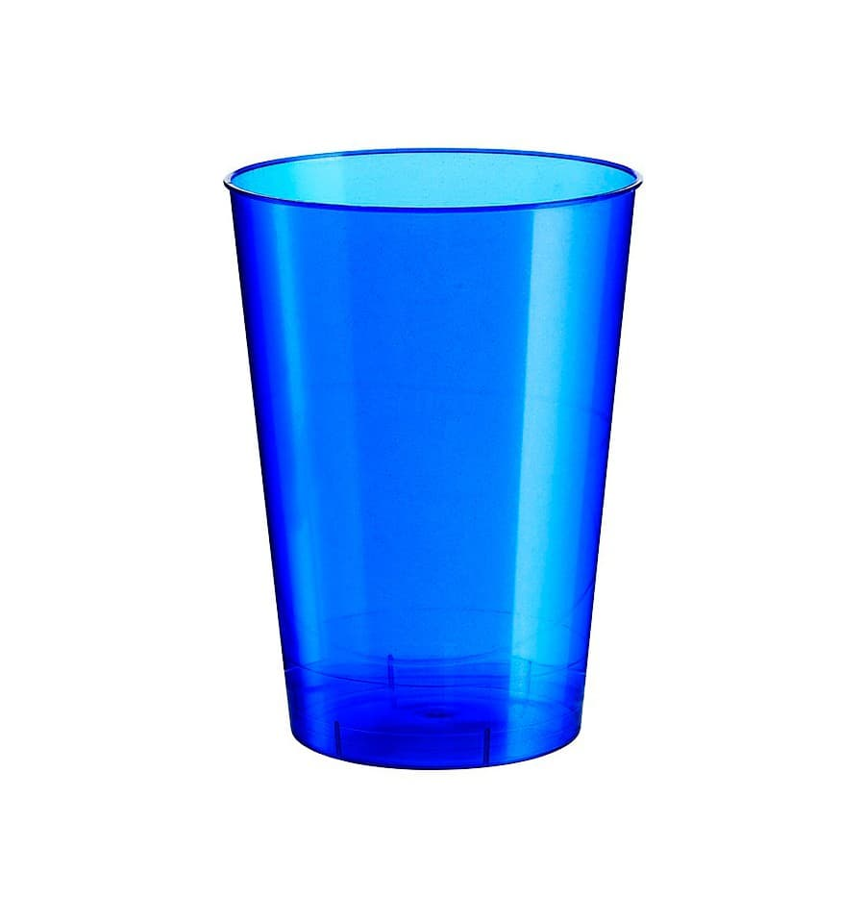
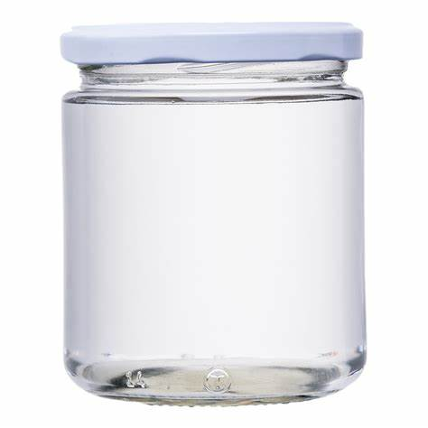
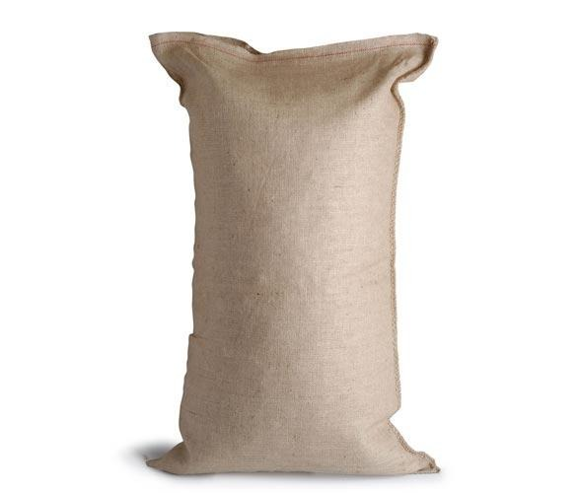
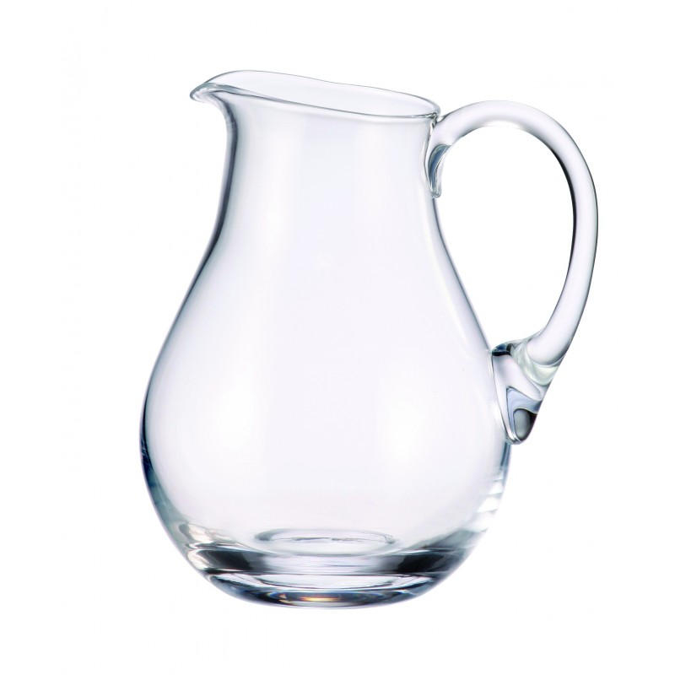
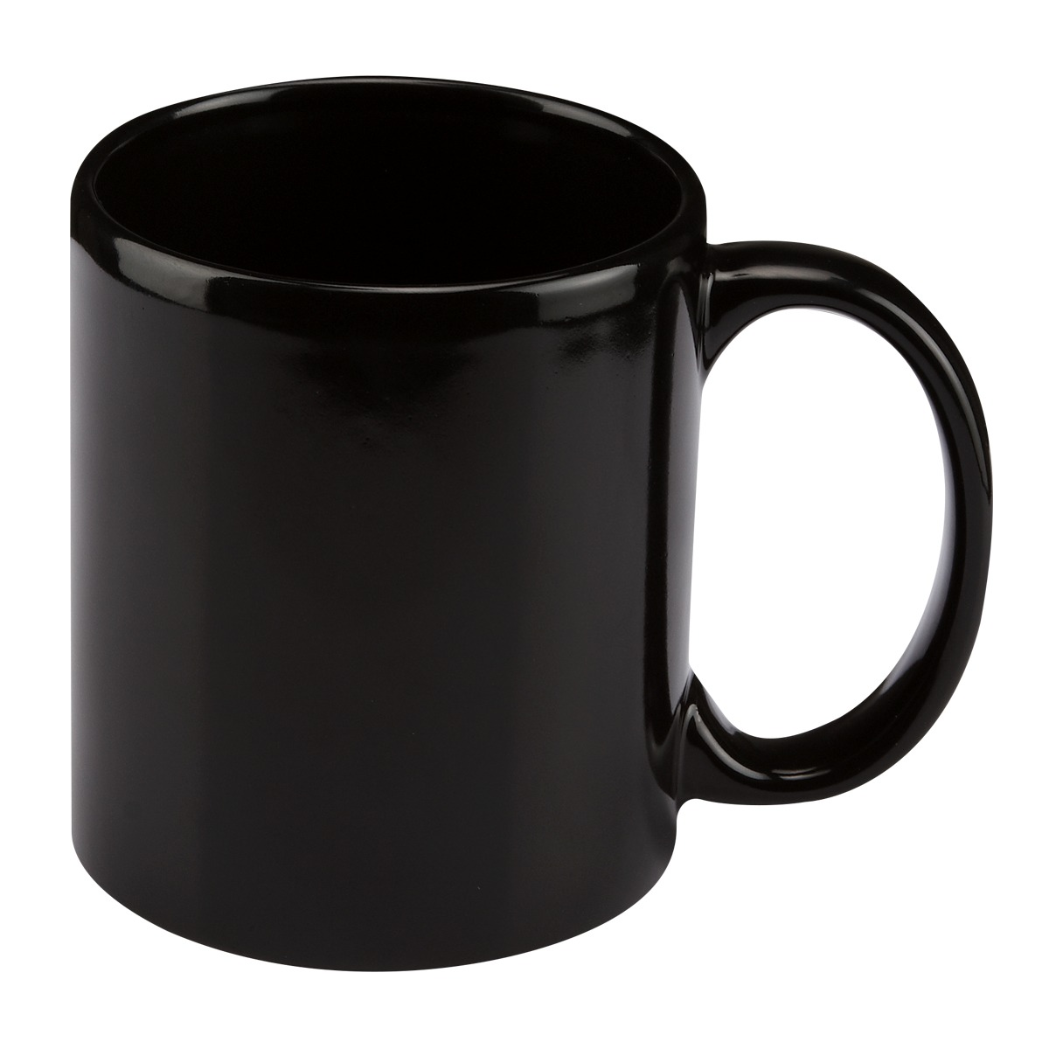
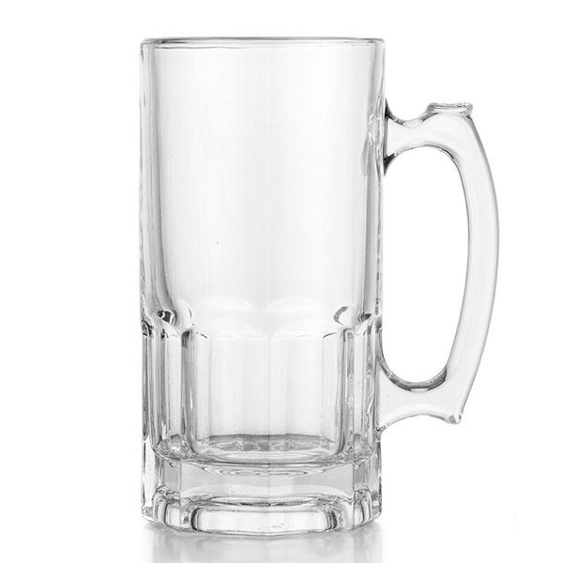
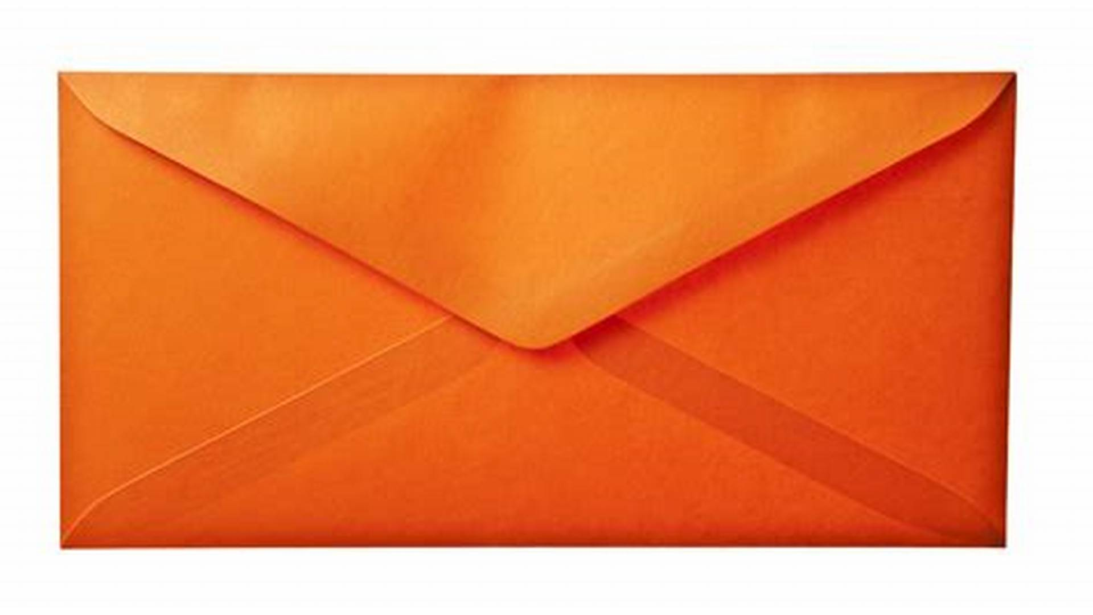
Spray can – atomizador
Jar – frasco
Glass - vaso
Sack – costal
Jug - jarra
Cup - taza
Pot – tarro
Envelope – sobre (de carta)

Slide 13

thanks for your attention

